Slide 1

Automation Testing
By- Manas

Slide 2
HANDLING SCREENSHOTS IN SELENIUM
We are using this option to capture screenshots in application using WebDriver. According to testing principles we need to take screenshot of application for every step-in test case as test evidence. In webdriver also we can take screenshot by using “TakesScreenshot” Interface and getScreenshotAs method. Once we take screenshot of application, we need to save in .png format (Portable Network Graphics).
To take a screenshot in Selenium, we use an interface called TakesScreenshot, which enables the Selenium WebDriver to capture a screenshot and store it in different ways. It has a got a method "getScreenshotAs() " which captures the screenshot and store it in the specified location.

Slide 3
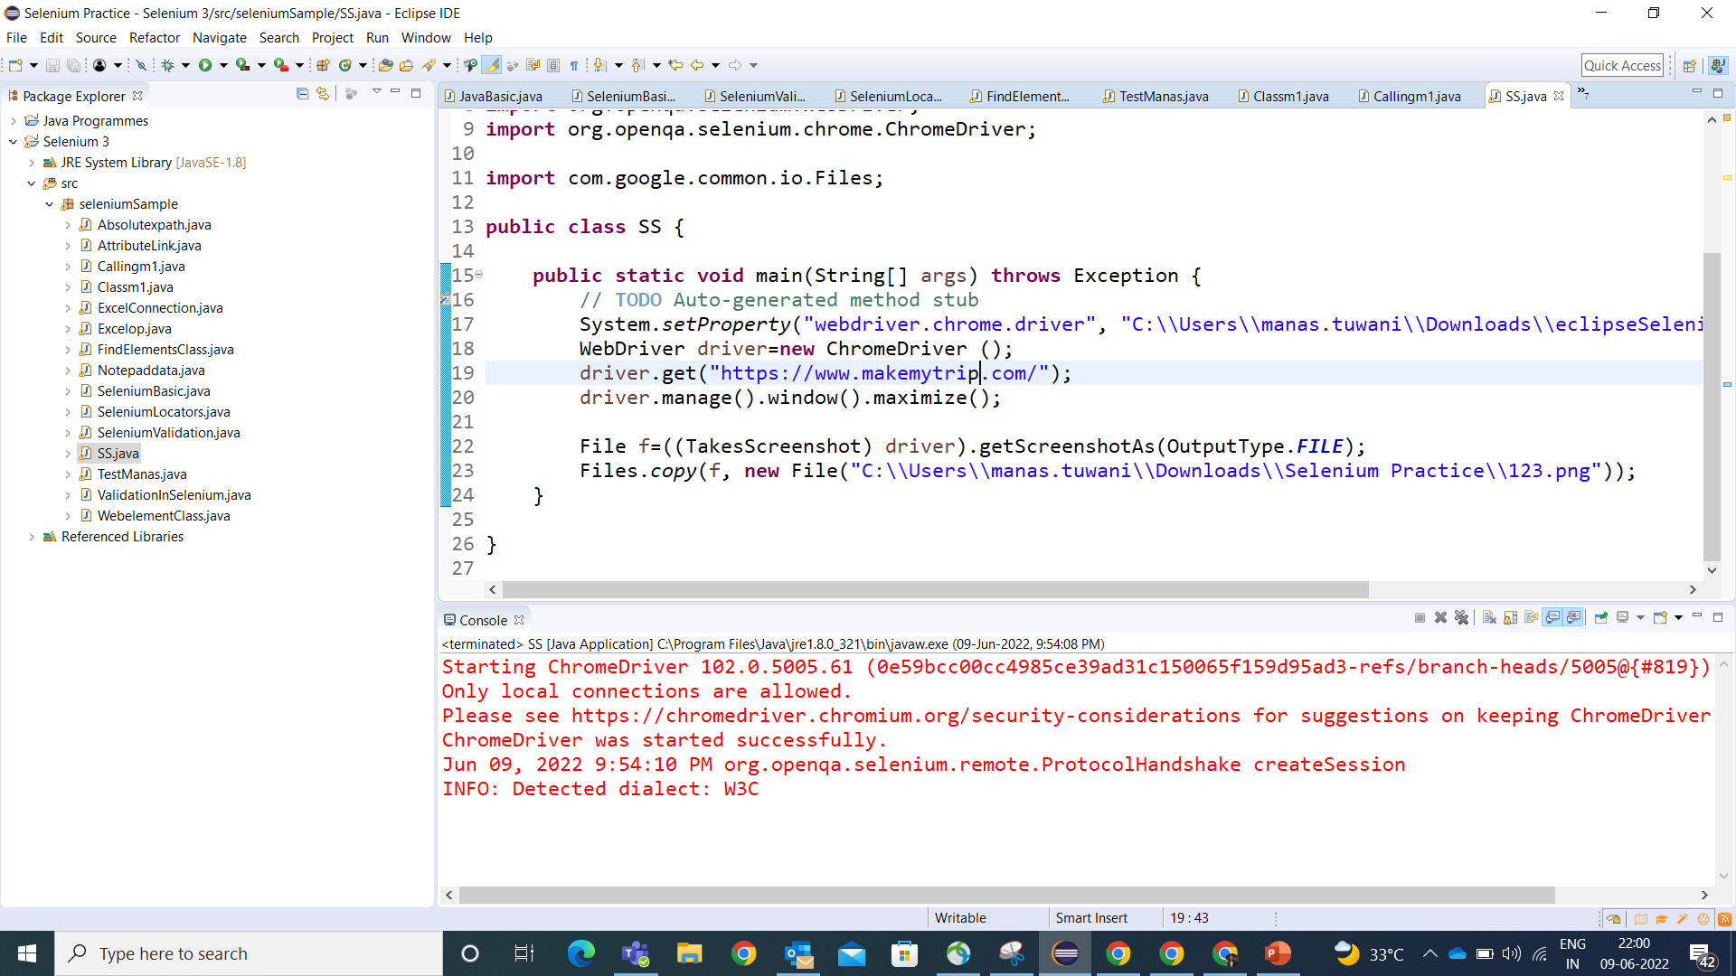

Slide 4
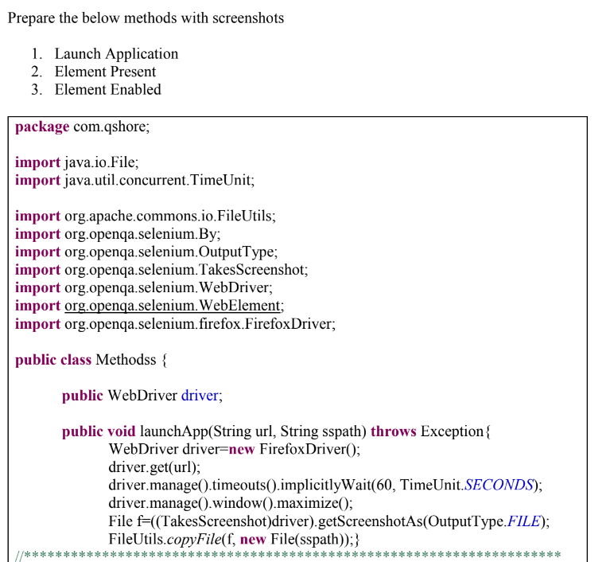

Slide 5
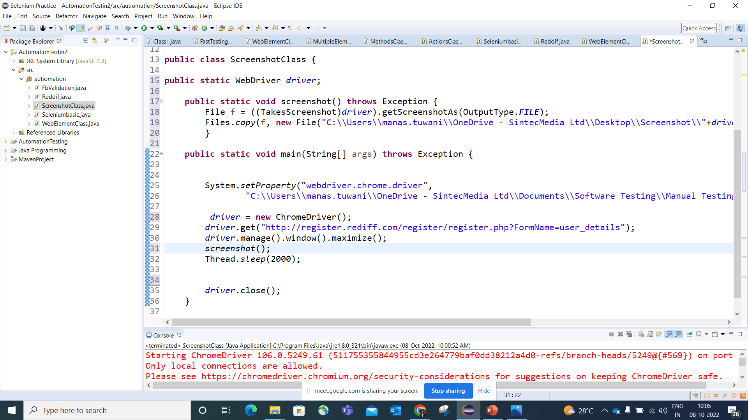
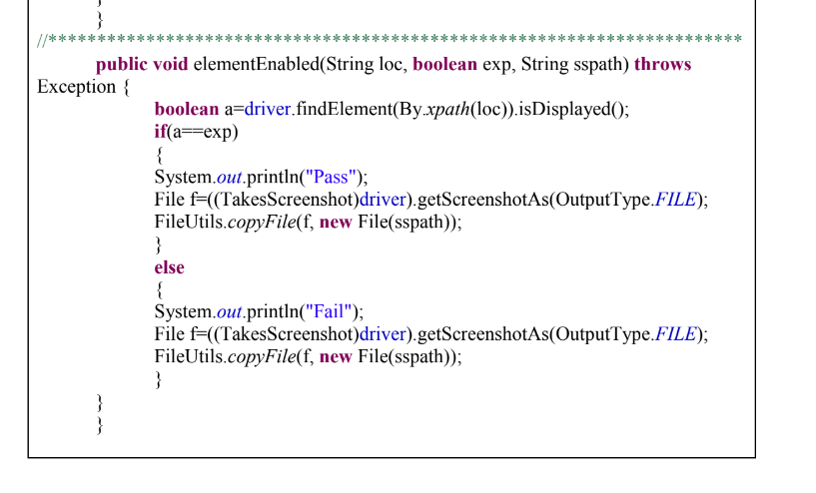

Slide 6
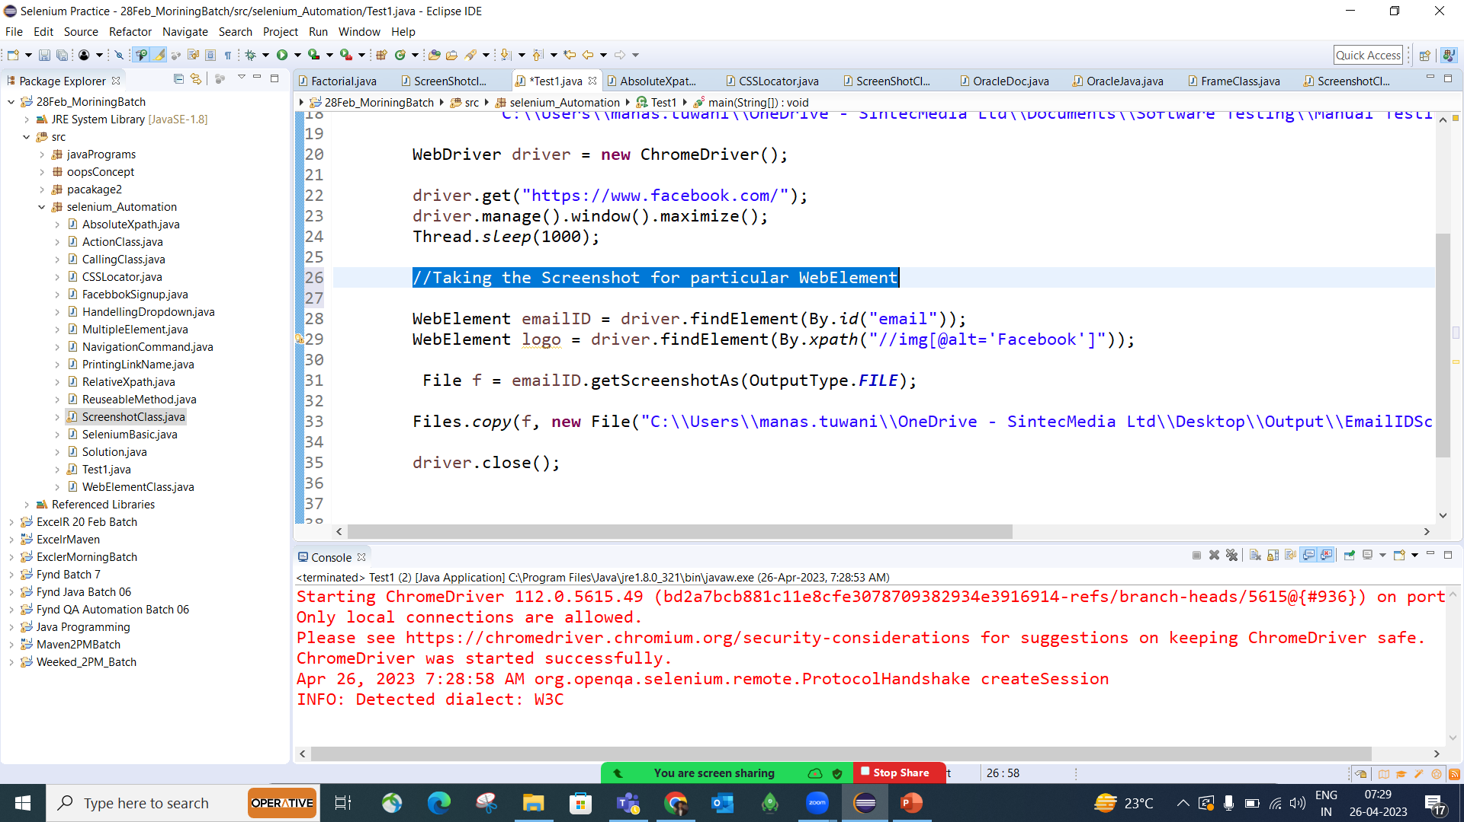

Slide 7
FAQs
1. How to take screen shots in webdriver
2. Create one method includes screenshot?
3. In which format screenshots are saving?
4. What is .png stands for?
5. Is screenshots are mandatory for testing?

